Slide 1
REACT NATIVE
OPEN SOURE SOFTWARES
CROSS PLATFORM
Ramprashanth
20C067

Slide 2

Introduction
FOSS- software developed by and for the community
Advantages
Higher quality
Greater reliability
Popular FOSS -- Android, Linux, React

Slide 3

About Tool
React is JS library/ Framework for creating User Interface.
React Native is a library that can compile react components into native components or widgets.
Created by Facebook
Initial release: March 26,2015
It allows us to use React to build native IOS or Android applications.

Slide 4


Advantages of React Native
Strong performance for mobile environments.
In React Native we can create one single codebase and build application for(saves time and money) both
Android , IOS

Slide 5
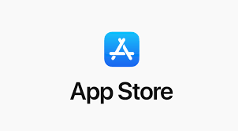

Advantages of React Native
It is based on JavaScript Language.
A compelling reason for using React Native instead of WebView-based tools
is to achieve 60 frames per second and
a native look and feel to your apps.

Slide 6


What is cross-platform?
Strong performance for mobile environments.
Android apps are coded
in Java
Using Android Studio
iOS apps are coded
In objective-C
Using XCode

Slide 7
What is cross-platform?
Apps written for Android not compatible with iOS.
Increases cost and time for creating and maintaining.
But by using cross platform like React Native, with single codebase we can run apps on both Android and iOS.

Slide 8


Similar open Source Tools
Flutter
Lightweight and cross platform framework created by Google
Uses Dart language

Slide 9
Thank You

